Slide 1
NOSA Symposium 2022
AF10 Aerosol Flowmeter –
Designed for aerosol laden gas
Julie Pongetti support@cambustion.com
Notes:
Thank you Jonas for your introduction, and thank you for inviting us as sponsors to this year’s NOSA symposium.
My name is Julie and I am an Aerosol Applications and Support engineer at Cambustion.
We are based in Cambridge, UK and are experts in developing scientific instrumentation. Our instruments are used in a range of industries, including aerosol science, air quality and engines exhaust emissions, and smoking and vaping.

Slide 2
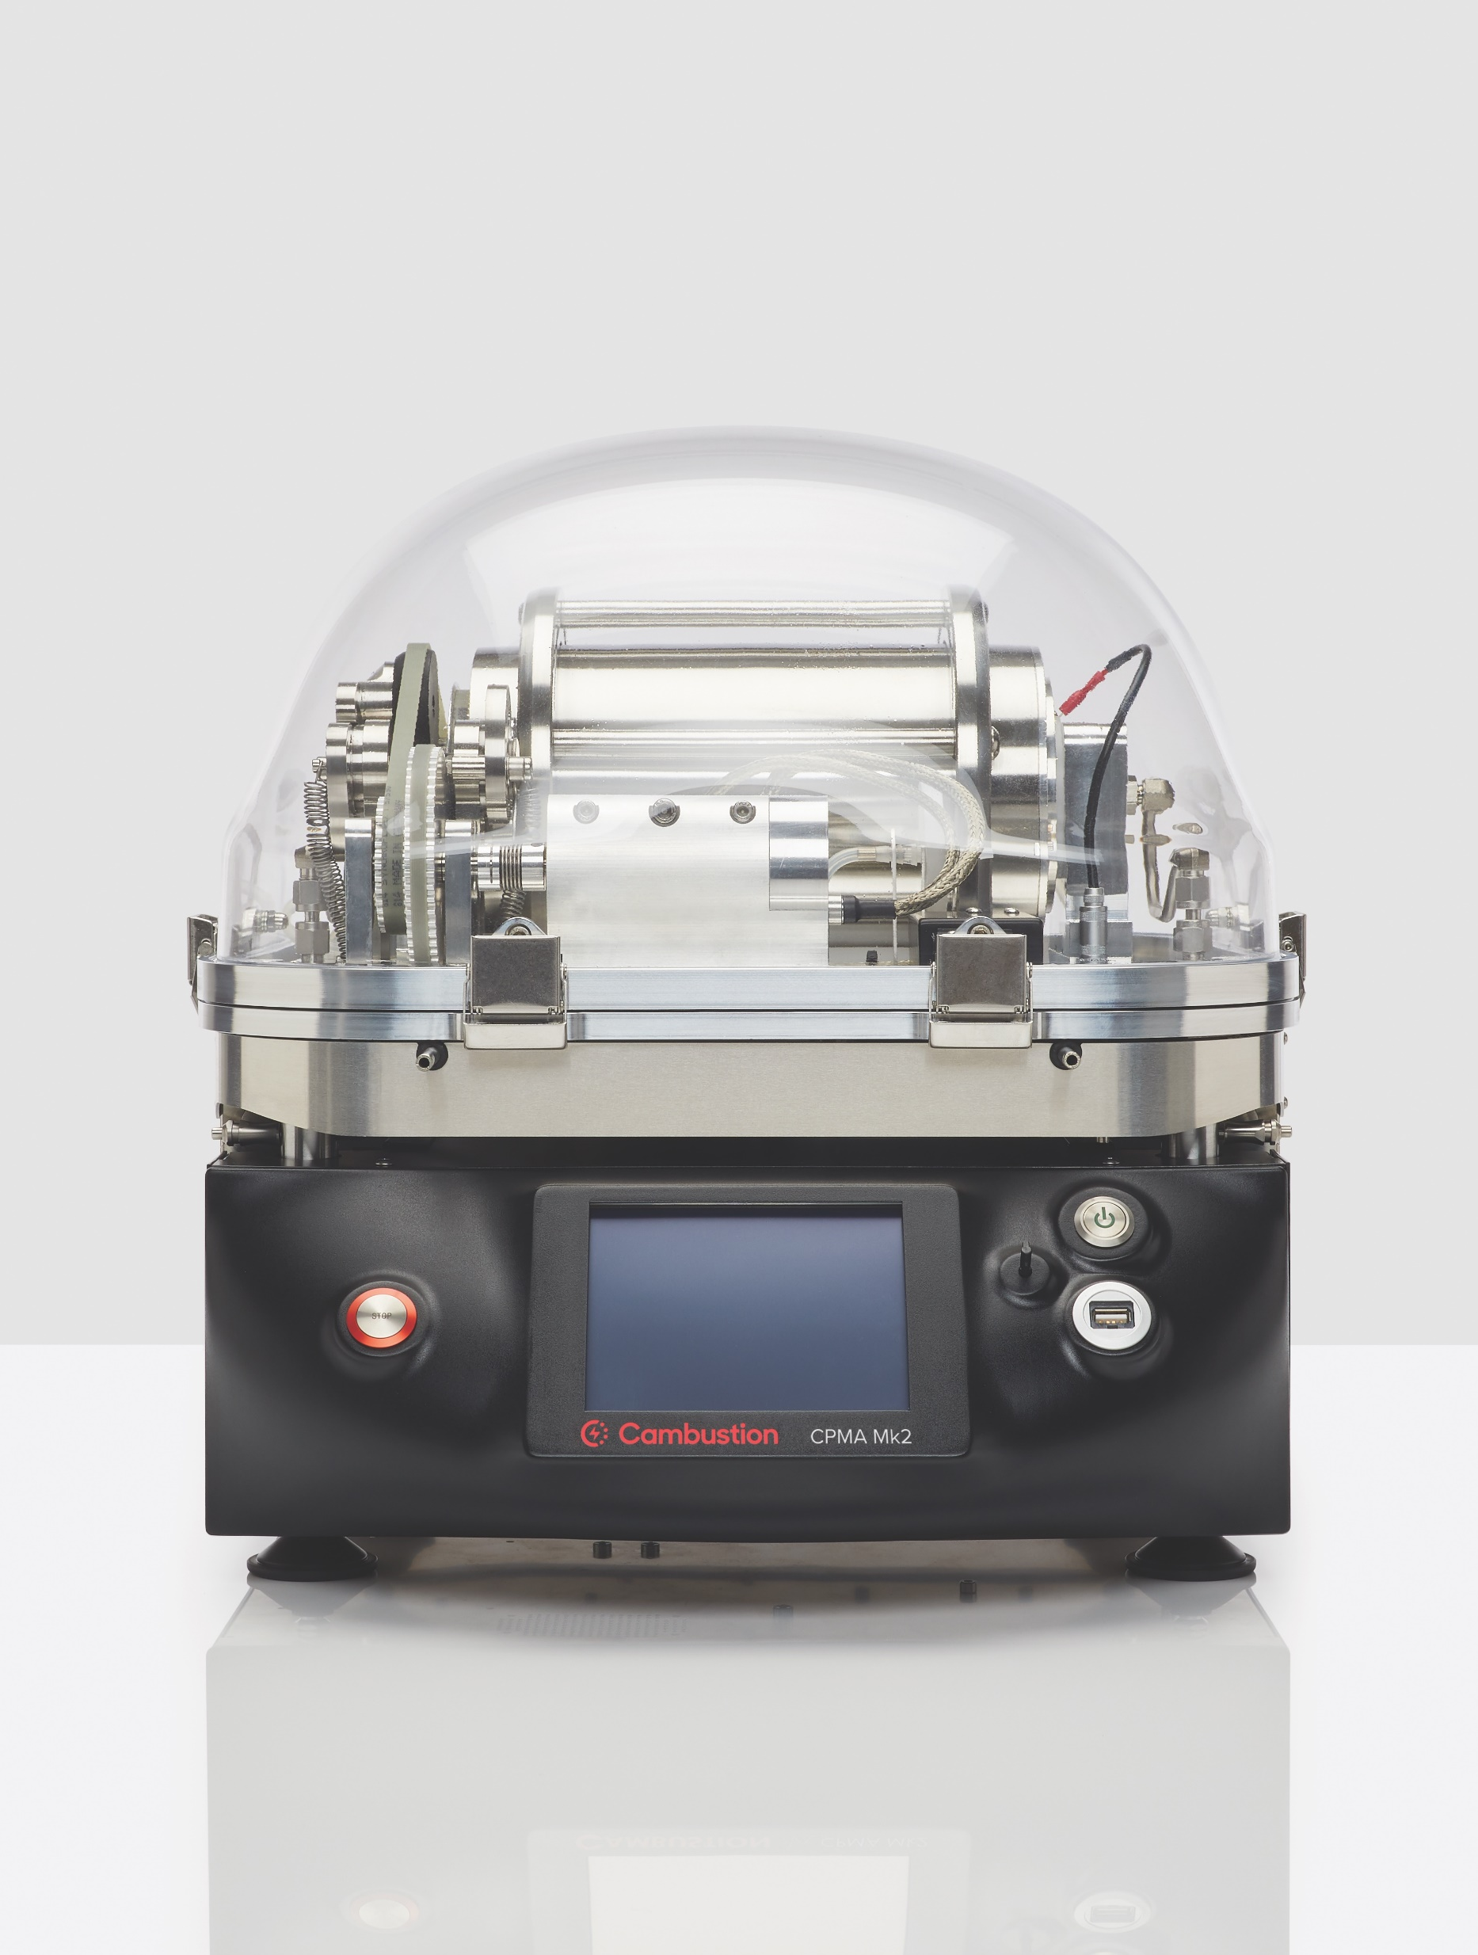
Some of our aerosol instruments
Notes:
Some of our most popular instruments used in aerosol science include the AAC Aerodynamic Classifier, the CPMA Centrifugal Particle Mass Analyzer, and the DMS500 Fast Aerosol Sizer.
However, today I would like to take these 5 minutes to introduce our latest instrument, the AF10 Aerosol Flowmeter.

Slide 3
Measuring aerosol flows
Why?
Check that a measurement instrument is operating correctly
Correct a measured parameter (e.g., accounting for diffusion losses, converting between volumetric and mass flow)
How?
Method | Measurement affected by the aerosol? | Aerosol flow affected by the measurement?
Hot wire | Yes | Yes
Rotameter | Yes | Potentially
Soap bubble | Yes | Yes
Orifice | Yes | No
Irreversible damage to the instrument?
Yes
No
No
No
Notes:
Being able to accurately measure flow rates is essential in virtually all aerosol experiments. This is to ensure that measurement instruments are operating correctly and drawing the flow they are designed for; or to correct measured parameters, for example to account for diffusion losses of particles.
There are many methods which are used to measure gas flows in general laboratory applications, but all of them encounter some problems when it comes to measuring aerosol flows.
The most common problem is the aerosol particles interfering with the measurement principle and offsetting the “calibration” of the measuring device. This includes affecting the convective heat transfer around a hot wire, depositing around a rotameter float or orifice throat, and changing the surface tension of soap bubbles.
Often, the aerosol itself is affected by the measurement. For example, because the temperature of the flow is changed, because tortuous paths increase particle losses, or because the relative humidity changes.
In extreme cases, the deposition of particles on the flow-measuring device might cause irreversible damage.

Slide 4
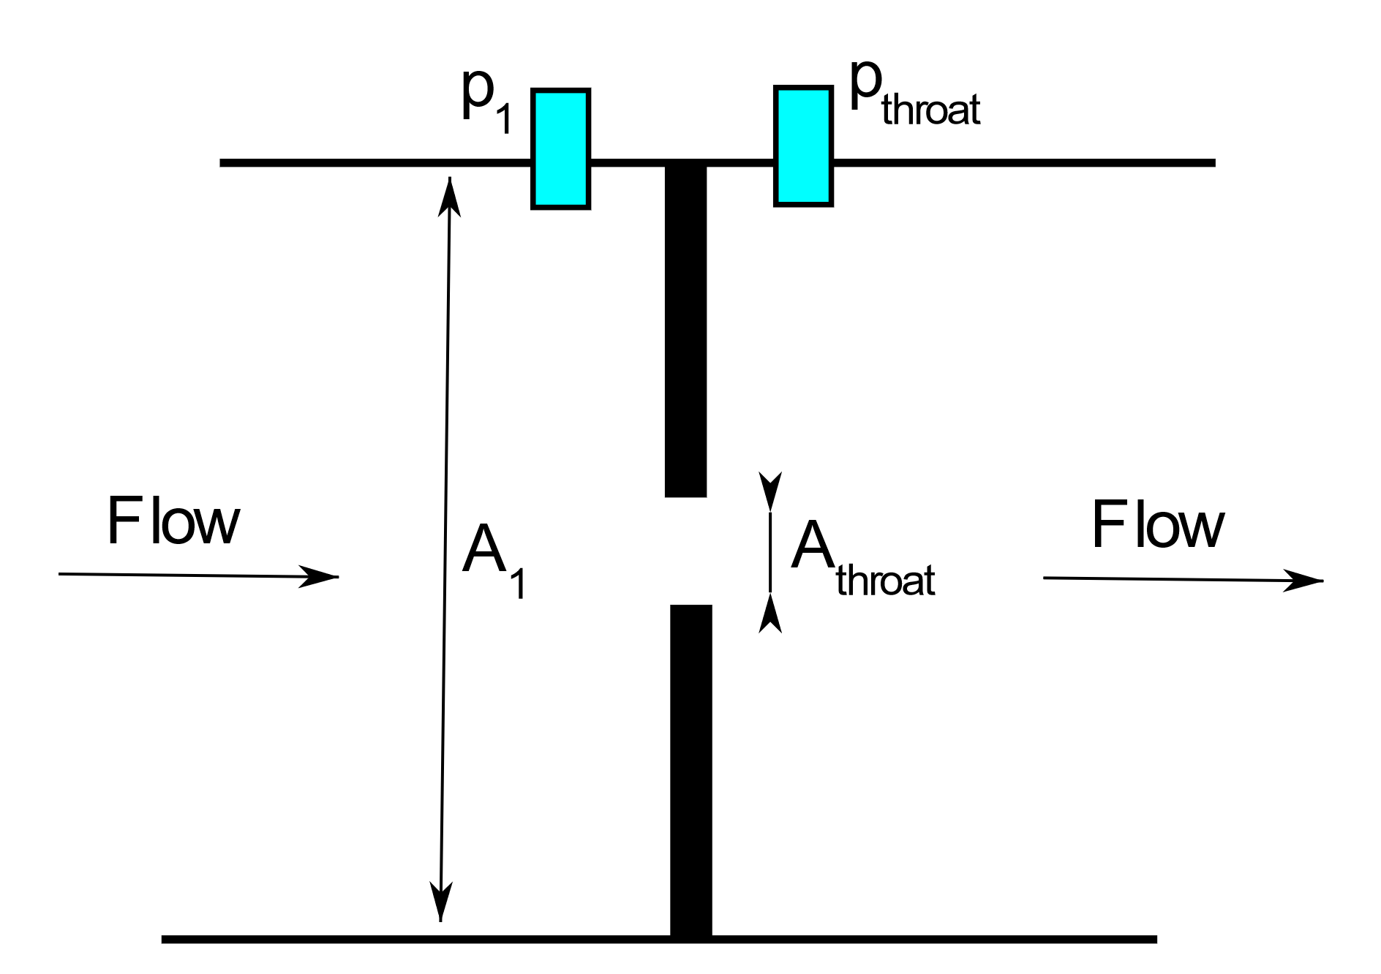
Flow through an orifice
Compressible flow through an orifice:
Gas properties ($γ$)
Gas conditions ($ρ_{1}$)
Pressure drop ($\frac{p_{throat}}{p_{1}}$)
Geometry ($\frac{A_{throat}}{A_{1}}$)
$C_{d}= {Q_{real}}/{Q_{ideal}}$ – a measure of the orifice performance, which varies with shape and Reynolds number
$$\frac{\dot{m}}{C_{d}}=A_{t}{\left(2 ρ_{1}p_{1}\left(\frac{γ}{γ−1}\right)\left({\left(\frac{p_{throat}}{p_{1}}\right)}^{2/γ}−{\left(\frac{p_{throat}}{p_{1}}\right)}^{{γ+1}/γ}\right)\right)}^{1/2}{\left(1−{\left(\frac{A_{throat}}{A_{1}}\right)}^{2}{\left(\frac{p_{throat}}{p_{1}}\right)}^{2/γ}\right)}^{{−1}/2}$$
Notes:
Gas flow through an orifice is very well understood. Given a few operating conditions, the mass flow can be calculated from the pressure drop across the orifice.
Specifically in the case of a compressible gas, we need to know the gas properties, the local gas density (which is obtainable from measurements of temperature and absolute pressure), and the orifice geometry.
The last parameter in the equation is the discharge coefficient Cd, which can be experimentally mapped for each orifice.

Slide 5
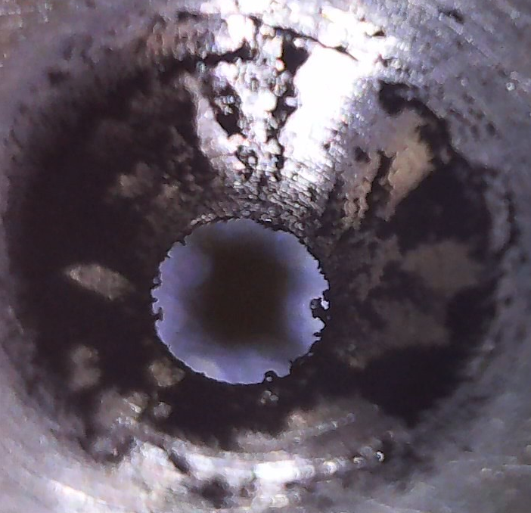
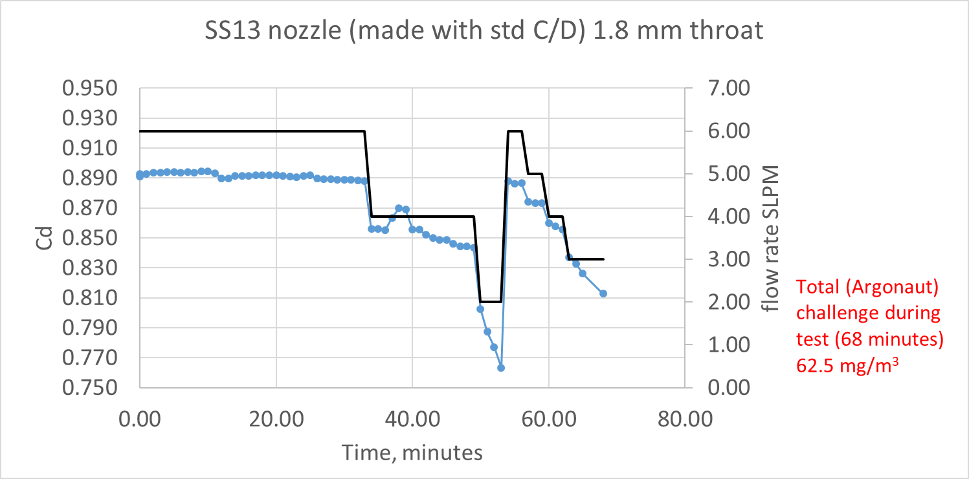
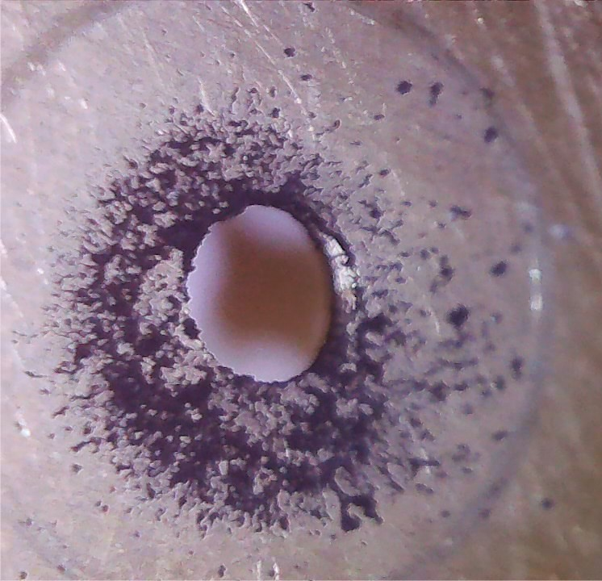
Aerosol flow through an orifice
The aerosol deposition on the orifice varies with flow rate:
At high flow rates $C_{d}$ is stable over time (the orifice self-cleans)
At lower flow rates $C_{d}$ decreases steadily (particles accumulate on the orifice)
The drop in $C_{d}$ becomes steeper as the flow rate is reduced
Front
Flow rate
C_{d}
“self-cleaning”
Flow rate (SLPM)
decreasing performance
Back
Time (minutes)
62.5 mg/m³ of Argonaut burner soot delivered over 68 minutes of testing
Notes:
This relationship remains valid for dilute aerosol flows, except that the deposition of particles on the front and back surface of the orifice affect on the long run the calibration curve.
The deposition of particles around the orifice cannot be easily accounted for, as it depends not only on the type and concentration of the aerosol used, but also on the flow rate itself.
At high flow rates the particles impacting the orifice have large momentum, which causes them to bounce off the surface, or to remove particles which have already deposited.
This sort of “self-cleaning” cannot happen however as the flow rate is lowered, and we therefore see the discharge coefficient dropping over time at a rate which depends on the gas flowrate.
To extend the principle of pressure drop through an orifice to measure aerosol flow rate, we therefore rely on being able to restore and guarantee the accuracy of the orifice calibration curve over time.

Slide 6
The Cambustion AF10
Compatible with solid, liquid, and mixed aerosol particles suspended in a wide range of gases
Uses measurement of pressure drop through an orifice
An integrated cleaning brush – actuated by a solenoid – removes accumulated material in less than 1 second
Includes four different sized (user-changeable) orifices, with flow rates overlapping to cover the range 0.1 – 10 lpm
Traceable calibration certificate
Touchscreen user interface
Interfacing via analogue, Ethernet and USB
Notes:
This is what we have achieved in our new AF10 instrument, which can withstand all kinds of aerosols and guarantees continued accuracy over long measurement times. This is possible thanks to an integrated cleaning brush which reliably cleans the orifice, while causing minimal flow disruption.
A set of 4 user-changeable orifices of different sizes allow flow measurements across a wide range of flows, spanning from 0.1 to 10 lpm.
This multiple orifice solution also gives users the possibility of reducing the pressure drop in the AF10, such that accurate measurements are achieved, without creating such a high pressure drop that downstream instruments (for example a CPC) are unable to operate correctly.

Slide 7
For more information
Visit our website:
https://cambustion.com/af10
Or email:
support@cambustion.com
Notes:
Having said this, I would like to thank you for your attention and to thank the organisers again for setting up this Symposium. If you have further questions about the AF10 or any of our instruments, I invite you to visit our booth where you can find more information from our website or talk to myself or my colleagues.
I hope you enjoy the next session of conference presentations.

